Slide 1
Basic Internship@Clevered Safety App
App User Manual
Author: Nazneen Fathima

Slide 2
Table of Contents
Table of Contents
Acknowledgements
About Me
About My Internship with Clevered
About Safety App
How do I use the Safety App?
Safe Scenario
Safe Scenario – Touch head/other than face
Unsafe Scenario – Touch nose
Unsafe Scenario – Touch eye/s
Contact Person

Slide 3
Acknowledgements
First and foremost, Thank God!
I would like to express my special thanks of gratitude to Smita Ma’am for the guidance and support in completing my project!
I would like to extend my deepest sense of gratitude to Mr. Ken Kahn for his valuable comments and expert guidance!
Thanks to my friends for the support and motivation!
Last but not the least, I would like to convey my heartfelt thanks to my parents for their support! Special Thanks to my Mom for her interest in my experimental results which motivated me to give my best.

Slide 4

About Me..
Student’s Introduction
Name: Nazneen Fathima
Grade: 2
School : Global Indian
International School
Place: Abu Dhabi, UAE
Student’s Photograph

Slide 5
About My Internship with Clevered..
It was a wonderful journey! I’ve learned new things and make new friends!
Badges Earned:
Received Rock star recognition 4 times in a row.
3 times for knowledge sharing!

Slide 6
About Safety App..
Safety App Introduction
An app that would simply run on a user’s browser , scanning the face and hand gestures and warns with a sound and notification whenever the user touch their face.
App changes its background once user is about to touch their face.

Slide 7
How do I use the Safety App?

Slide 8
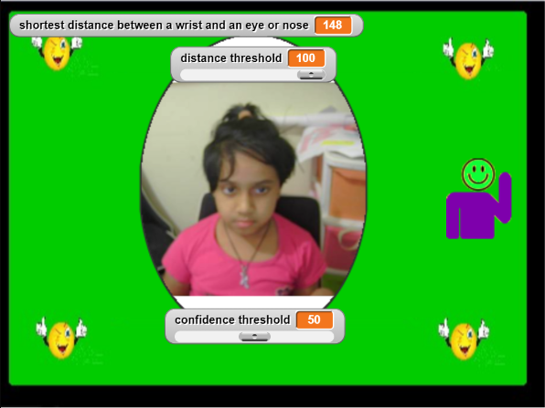
Safe Scenario
Set distance threshold to a number – example: 100
Normal scenario – when user doesn’t touch his/her face.
The application will stay with green background with no notification.

Slide 9
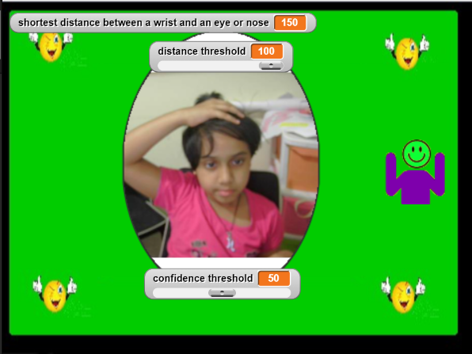
Safe Scenario – Touch head/other than face
Set distance threshold to a number – example: 100
Touch head/neck area with left or right hand
The application will stay with green background with no notification.

Slide 10
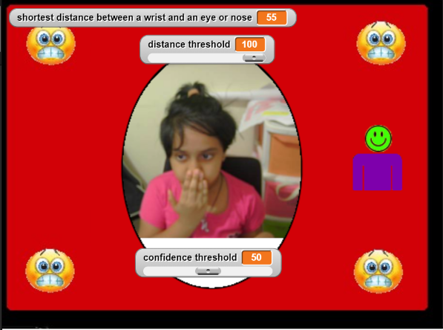
Unsafe Scenario – Touch nose
Set distance threshold to a number – example: 100
With right or left hand if try to touch his/her nose.
When the distance between hand and face gets less than distance threshold, background changes to red colour and warning sound comes which says “Don’t touch your face”.

Slide 11
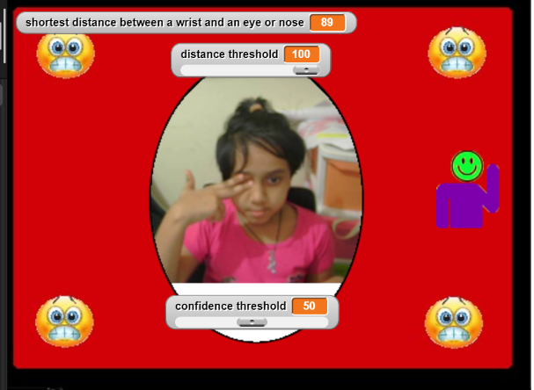
Unsafe Scenario – Touch eye/s
Set distance threshold to a number – example: 100
With right or left hand if try to touch his/her eyes.
When the distance between hand and face gets less than distance threshold, background changes to red colour and warning sound comes which says “Don’t touch your face”.

Slide 12
Contact Person
Please reach out to Nazneen Fathima @ NazneenShefeeque@gmail.com for any questions/ concerns/ suggestions on the App

Slide 13
Thank you!

